Slide 1







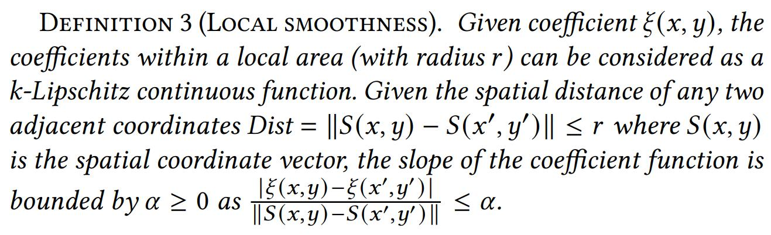
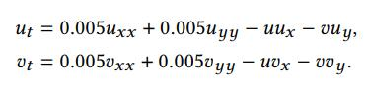
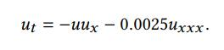
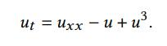

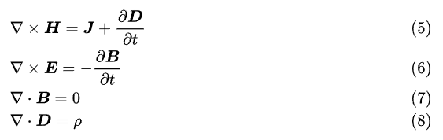
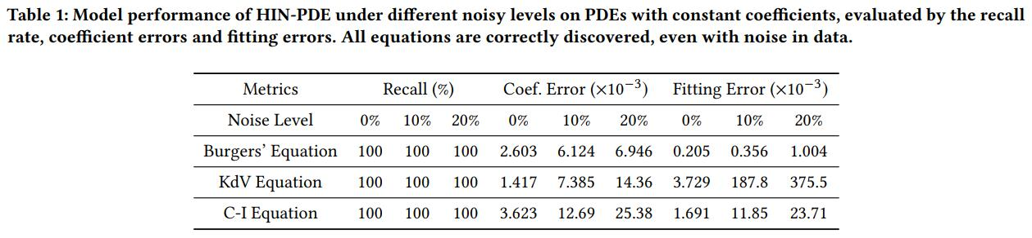
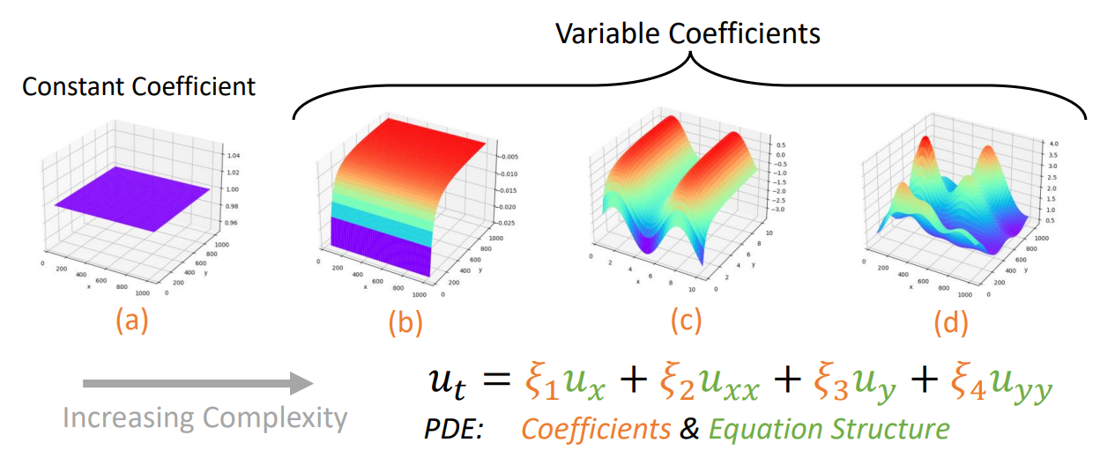
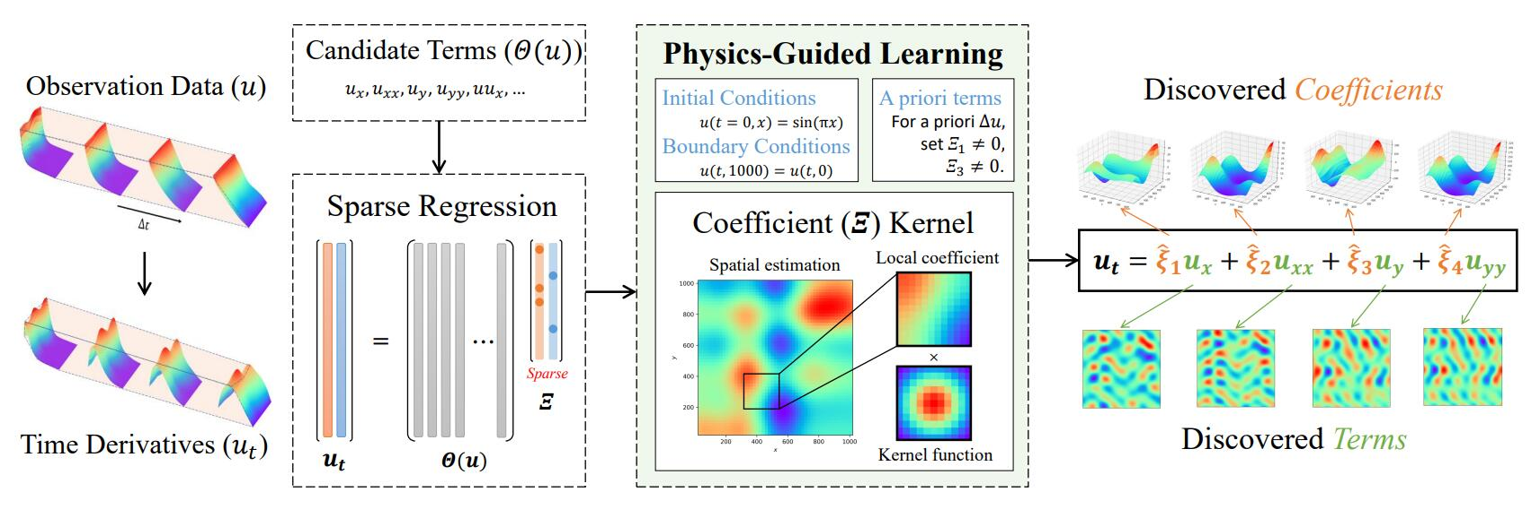
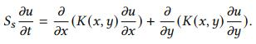
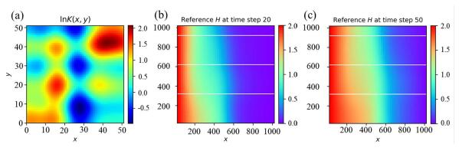
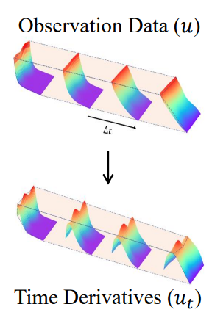
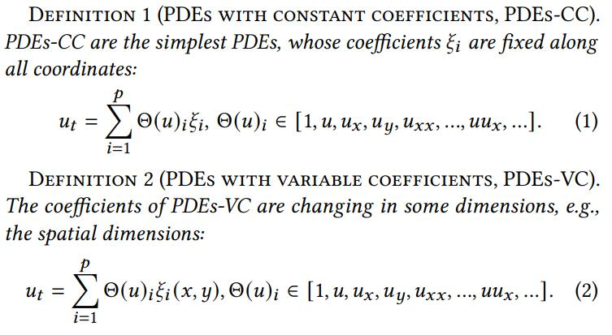
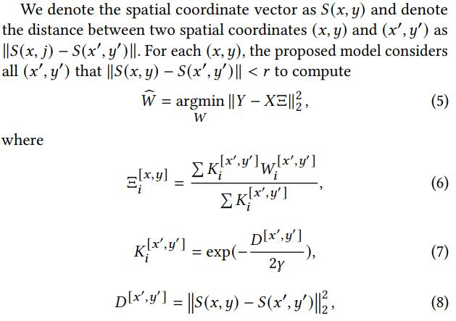
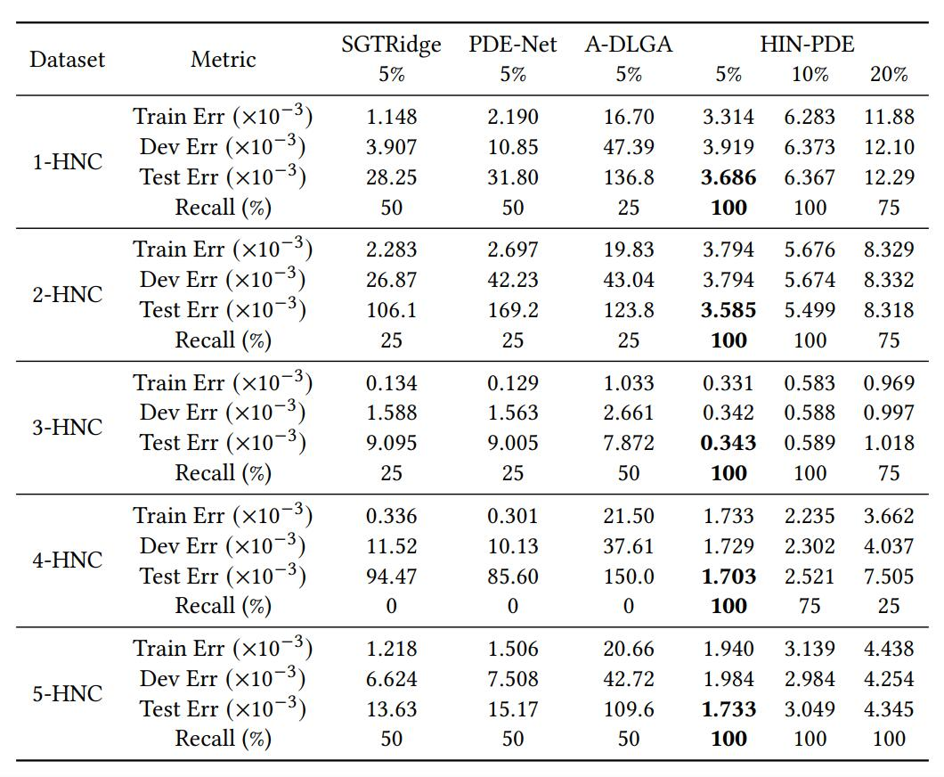
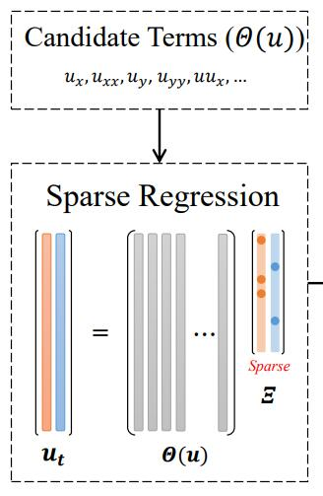
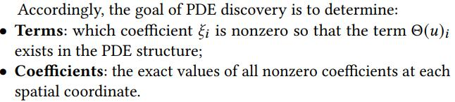
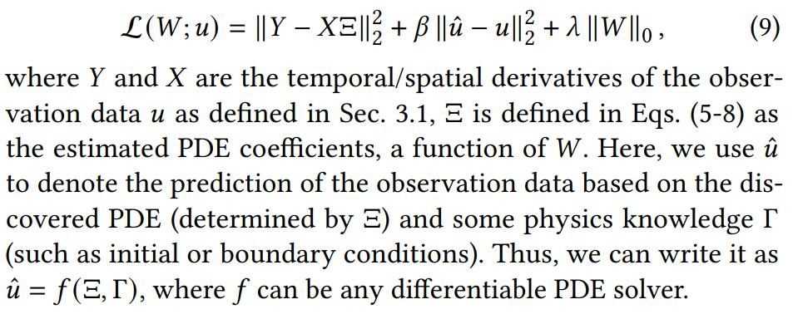
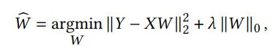
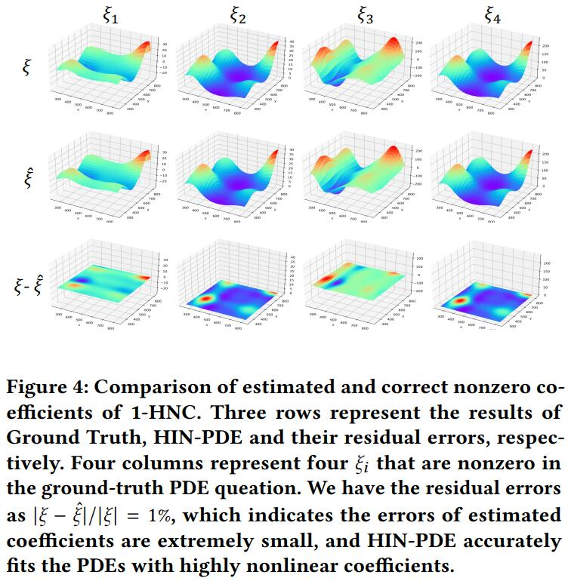
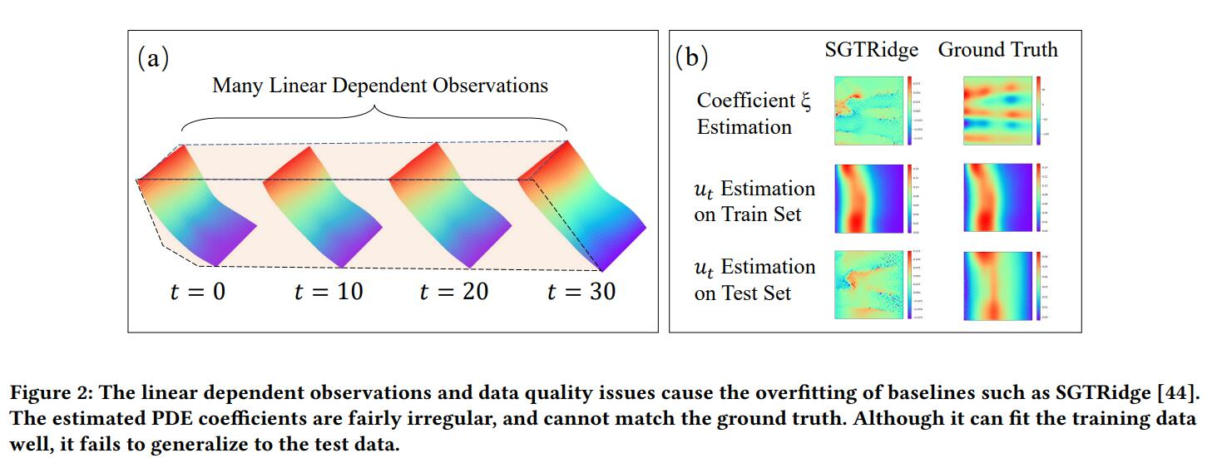
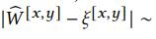
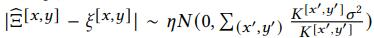
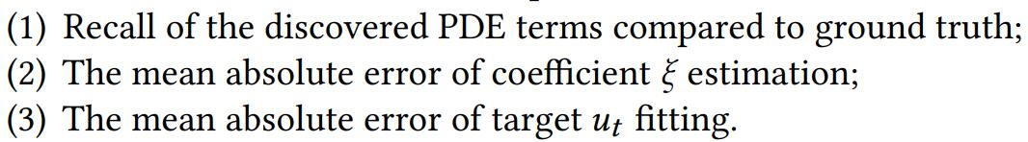


Physics-Guided Discovery of Highly Nonlinear
Parametric Partial Differential Equations
$$\text{Yingtao} \text{Luo}\text{, }\text{Qiang} \text{Liu}\text{, }\text{Yuntian} \text{Chen}\text{, }\text{Wenbo} \text{Hu}\text{, }\text{Tian} \text{Tian}\text{, }\text{Jun} \text{Zhu}$$
Background
Motivations
Results – Constant Coefficient
Partial Differential Equations (PDEs) are ubiquitous.
Physics Knowledge as Constraints:
Initial and boundary conditions, a priori terms.
Physics Principles as Constraints:
Conservation laws, smoothness.
Burgers’ Equation
KdV Equation
C-I Equation
Based on observations, scientists explain electromagnetism by:
Recall: Differentiation smoothness is a first principle.
Scope: Most physical fields. For those with mutations or discontinuities, need shock/discontinuity-capturing methods).
Problem & Challenges
Results – HIN Coefficient
Methodology
Five governing equation cases of underground seepage (a form of Convection–diffusion equations)
where 𝑆𝑠 denotes the specific storage; 𝐾(𝑥, 𝑦) denotes the hydraulic conductivity field; 𝑢 denotes the hydraulic head. 𝑢 is the physical field. 𝐾 is the coefficient field as shown below. The hydraulic conductivity field 𝐾(𝑥, 𝑦) is set to be heterogeneous to simulate real situations, which is random fields with higher complexity.
(a) 1, (b) −1/𝑥, (c) −1/𝑥 + sin𝑦, (d) Highly Nonlinear (HIN) coefficient
PDE-Net/SGTRidge/A-DLGA
Ours
Parameters
Coefficients
Sparse Regression (filter irrelevant terms):
Knowledge Constraint
Independent coefficient estimation across space
Theoretical Properties
Kernel Complexity: Linearly proportional to the size of the dataset.
(The data used for estimating coefficient is “local”)
Estimation Error: Strictly lower than works like Adaptive-DLGA.
(Far-away coefficients have low density in kernel)
Robustness: Strictly lower than independent coefficient estimation.
For I.I.D. Gaussian noises,
which is lower than
Mesh-Free: (Kernel only calculates spatial distance. No grid is needed.)
State-of-the-arts in all three metrics:

